Slide 1


A New Vision for Enterprise Data
Horia Constantinescu
Country Manager CEE
Bucharest, November 12th, 2025

Slide 2
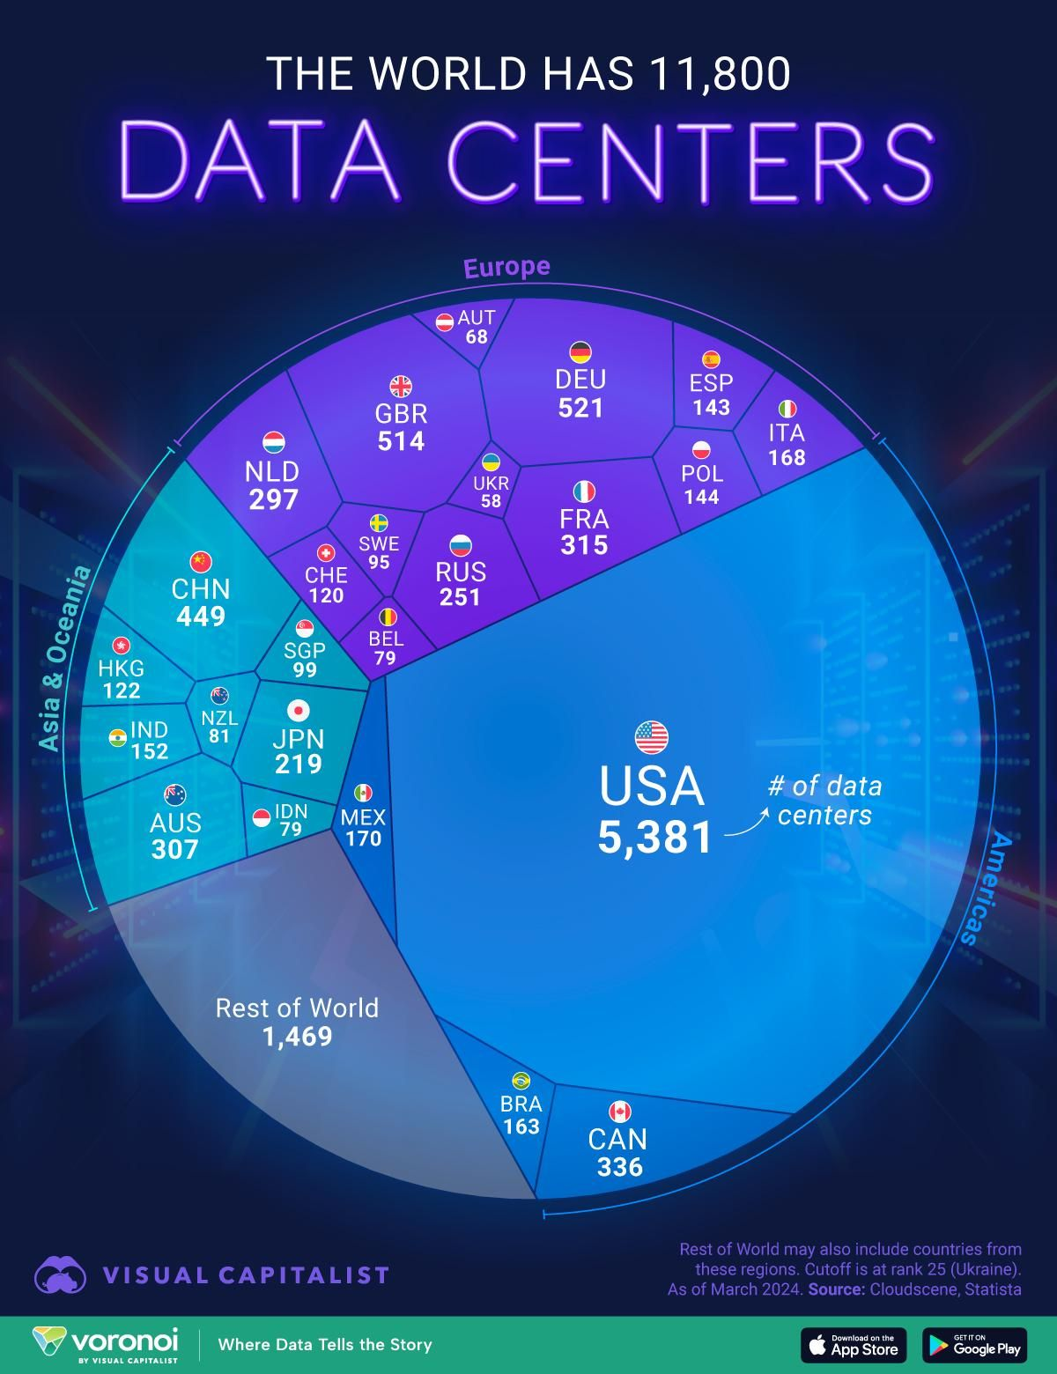
Notes:
Open with the big idea: once you accept that data, not infrastructure, is the foundation, priorities flip.
Call out the baseline: automating storage or tuning infrastructure isn’t the goal — that’s just table stakes.
Use the analogy: infrastructure is the plumbing, but data is what fuels the business and drives the outcome.
In an AI world, managing infrastructure block by block is too slow and too narrow.
The real work is managing data directly — intelligently, automatically, and in real time.
Land the takeaway: this isn’t optimization, it’s survival in a data-led, AI-powered world.

Slide 3
It’s time to Manage Your Data,
not Just Your Infrastructure
Notes:
Open with the big idea: once you accept that data, not infrastructure, is the foundation, priorities flip.
Call out the baseline: automating storage or tuning infrastructure isn’t the goal — that’s just table stakes.
Use the analogy: infrastructure is the plumbing, but data is what fuels the business and drives the outcome.
In an AI world, managing infrastructure block by block is too slow and too narrow.
The real work is managing data directly — intelligently, automatically, and in real time.
Land the takeaway: this isn’t optimization, it’s survival in a data-led, AI-powered world.

Slide 4

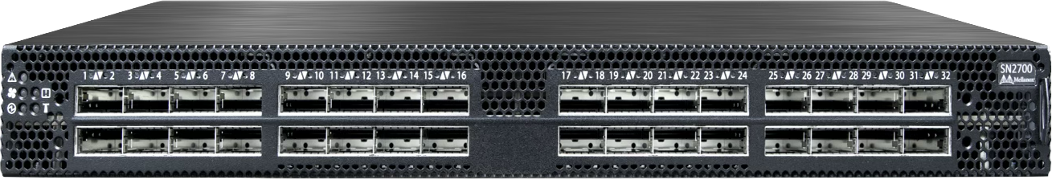
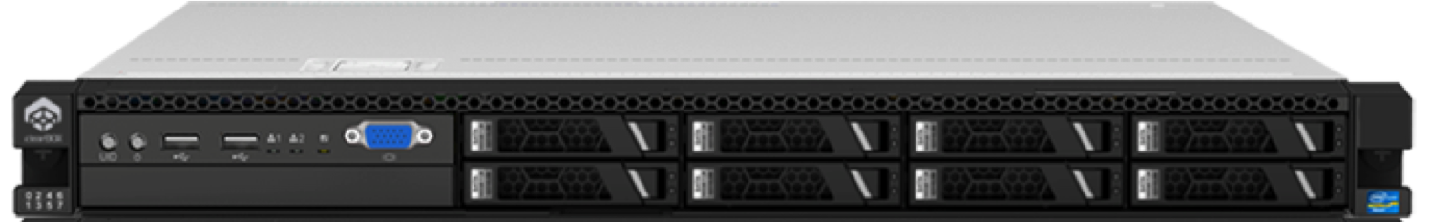
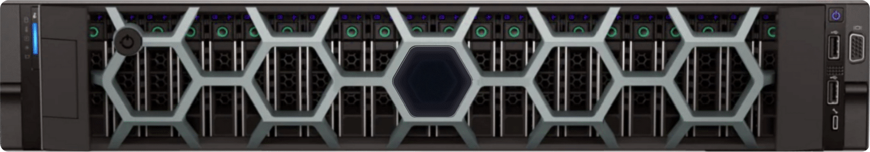
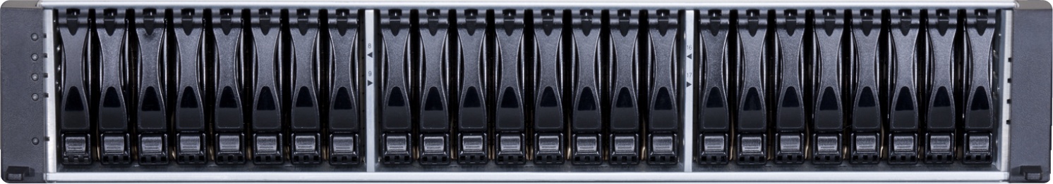
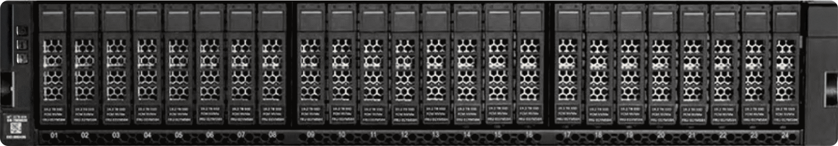
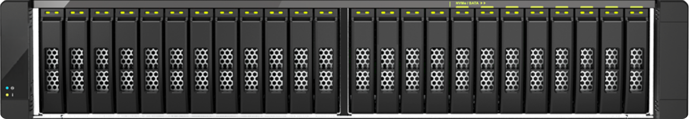
Traditional Enterprise Data Center Architecture
DATABASE
VIRTUALIZATION
FILE SHARE
BACKUP
Switches
Compute
Storage
Arrays are managed
and provisioned
individually
Can’t share capacity
or performance with
other arrays
New services
allocated and
configured manually
Data governance
standards applied
manually
©2025 Pure Storage
4
Notes:
Open with the key question: If managing data is the goal, not systems, how are we doing that today?
Acknowledge the reality: storage architecture hasn’t changed since the '80s
Flash replaced spinning disks, but the overall design didn’t evolve
Show the contrast:
Compute is virtualized — run any app on any server
Network is virtualized — traffic flows wherever needed
Storage is the outlier: Still fixed to the application stack
Bought, sized, and tied to a single-use case
Each workload — DB, AI, backup, file — has its silo
Often still managed manually
Result: Data is trapped in stacks, making it hard to share or repurpose.
Global policies are nearly impossible to apply
Data stays tied to infrastructure, not managed as a fluid asset.
We’re still treating storage like an external hard drive
Takeaway: the rest of the data center moved forward — storage stayed stuck, and now it’s the bottleneck

Slide 5

Enterprise Storage must transform,
not stay stuck in legacy complexity
Notes:
Start with a quick recap: legacy storage is manual, siloed, and tightly coupled to specific stacks.
Shift the tone: this isn’t a dead end — there’s already a working model — and it’s proven at scale.
The public cloud showed how to deliver shared, on-demand, policy-based data services.
Set up the next idea: what if we applied the same model to enterprise storage?

Slide 6
Enterprise Infrastructure must transform,
not stay stuck in legacy complexity
Notes:
Start with a quick recap: legacy storage is manual, siloed, and tightly coupled to specific stacks.
Shift the tone: this isn’t a dead end — there’s already a working model — and it’s proven at scale.
The public cloud showed how to deliver shared, on-demand, policy-based data services.
Set up the next idea: what if we applied the same model to enterprise storage?

Slide 7
Traditional Storage Architecture
is Vertical | Physical | Manual | Siloed
Modern Storage Architecture
is Horizontal | Virtual | Automated | Unified
Notes:
Frame the topic: cloud storage isn’t just more efficient — it’s a different foundation for modern IT
Contrast with the traditional model:
Vertical — one app, one stack, tied to hardware
Manual — provisioning, tuning, troubleshooting, nonstop
Siloed — data boxed in, hard to move or share
Show how modern storage based on cloud architecture flips it:
Horizontal — one platform, many apps
Virtual — hardware abstracted, infrastructure stays flexible
Automated — policies take over, hands off
Unified — data flows, scales, and serves the whole business
Land the takeaway: this is a reset for the storage industry — and it’s the platform for what comes next

Slide 8

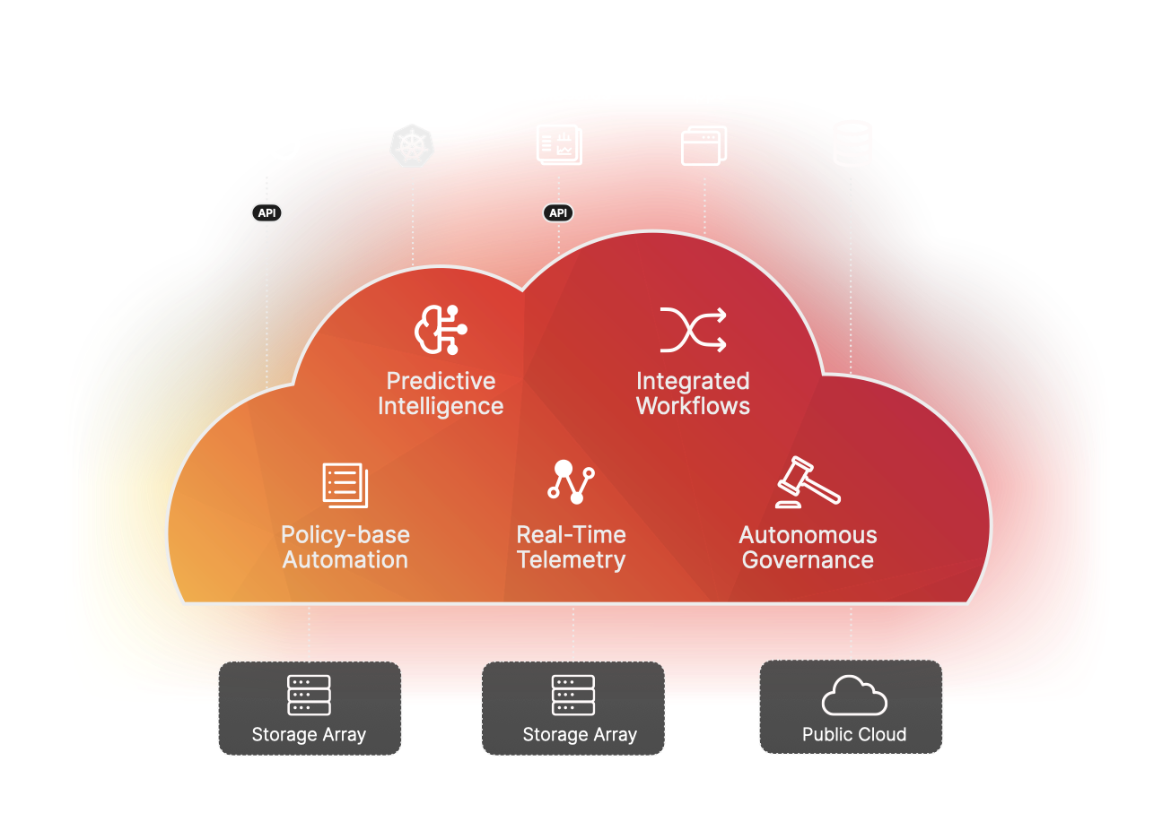
A new vision for Enterprise Data
Unified Data Plane
Intelligent Control Plane
Simple self-service, scalable consumption model
Supports all workloads & workflows
Notes:
Start with the core challenge: But how do we deliver this modern, cloud-like data experience everywhere?
Frame the solution: By building an Enterprise Data Cloud.
Explain what it brings together:
Unified Data Plane
Breaks down silos
Creates one data layer across all environments
Intelligent Control Plane
Automates daily operations
Enforces governance, responds in real time to changes
Self-Service, Scalable Model
Cloud-like provisioning, scaling, and protection
No manual tickets or operations
Support for All Workloads
From enterprise apps to AI and analytics pipelines
Land the takeaway: This isn’t a product — it’s a unified architecture and new operating model for modern storage

Slide 9

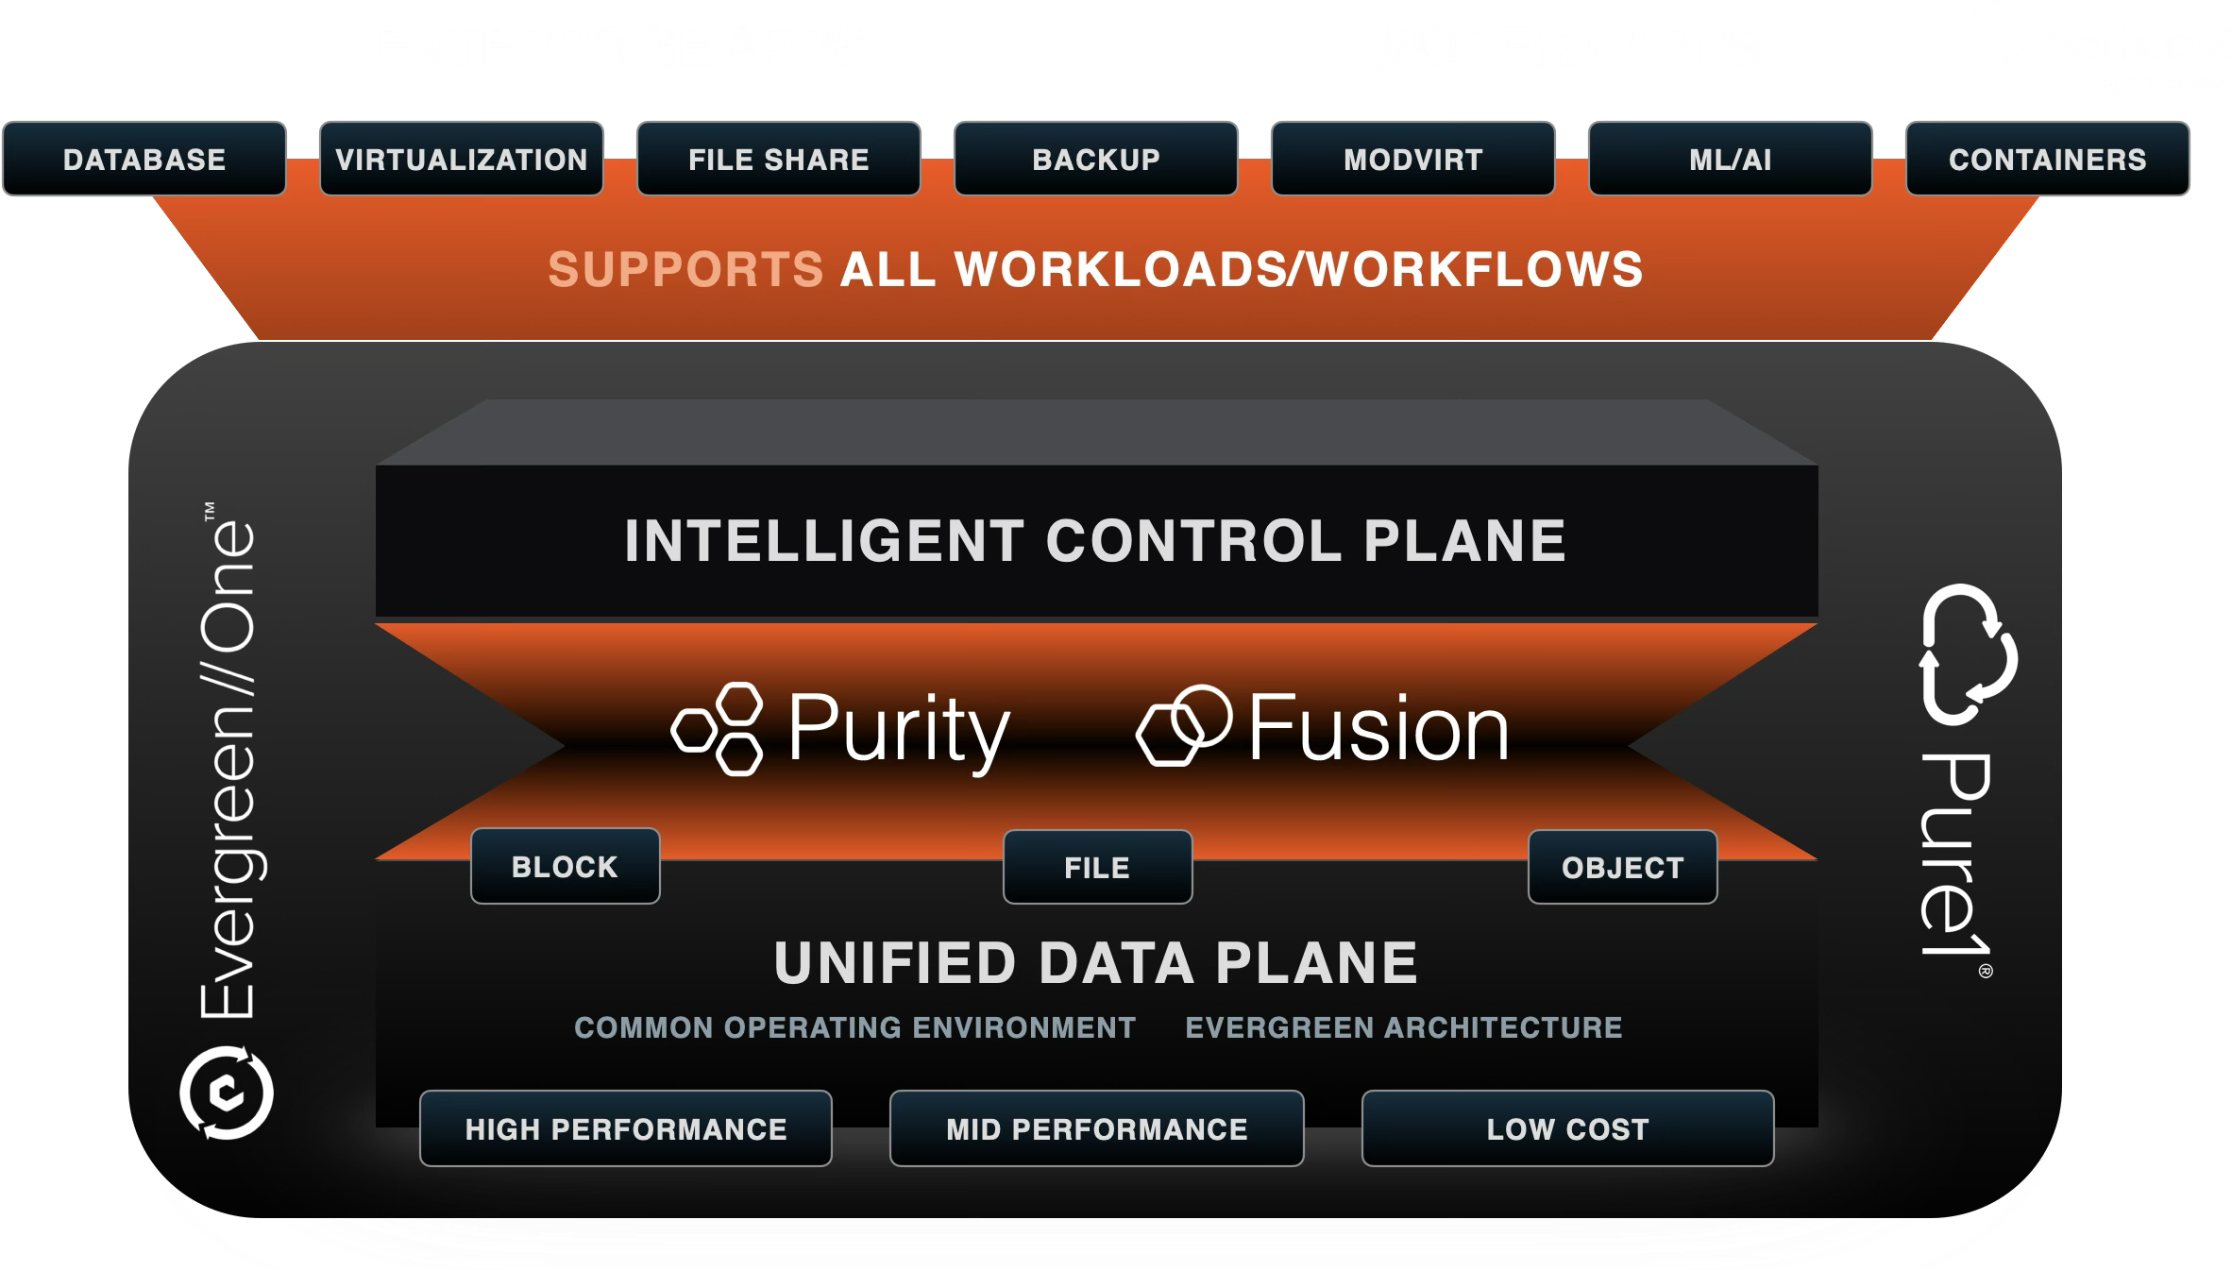
Your Enterprise Data Cloud
Delivered by the Pure Storage Platform
Virtualized Cloud of Data
Consistent Environment - All Workloads
Autonomous Data Governance
Built-In Cyber Resilience
Software Defined, Global Scalability
ON-PREMISES
PUBLIC CLOUD
EDGE
Notes:
Recap the big picture: Enterprise Data Cloud, powered by the Pure Storage Platform, delivers modern data services.
No more isolated arrays, no more manual effort
Define the model: software-defined, policy-driven, and globally enforced
Call out intelligent control: data is mobile, accessible, and centrally governed — by design
Emphasize automation: policies and workflows run the show — not scripts or hands-on tweaks
Highlight security: cyber resilience is built in from the start, not bolted on later
Land the takeaway: This isn’t storage with a few cloud features — it’s a full cloud operating model

Slide 10






Why can’t others do this?
FRAGMENTED, MULTI-SYSTEM ARCHITECTURES
COMPLEX, MANUAL MANAGEMENT
PRE CLOUD ARCHITECTURES
DISRUPTIVE UPGRADES & DATA MIGRATIONS
INCONSISTENT SECURITY & COMPLIANCE
HIGH COSTS & INEFFICIENCIES
Notes:
Set the stage: Most vendors talk about cloud and automation, but they’re still anchored to legacy foundations.
They’re still built on legacy silos — block here, file there, cloud off to the side
Highlight the workaround problem: extra software layers don’t unify; they just add complexity
Point to the missing link: no unified control plane means fragmented workflows, manual steps, and reactive resilience
Expose the lifecycle problem: they still rely on periodic re-architecture, migrations, and disruption
Frame it clearly: that’s not cloud — it’s legacy wrapped in new labels
Contrast with Pure’s approach:
The Evergreen model eliminates disruption
Virtualized cloud of data breaks silos for good
Intelligent control plane enables autonomous ops
Flexible delivery — buy, subscribe, or both — with consistent SLAs and full control
Land the takeaway: this isn’t a feature gap — it’s a fundamentally different operating model, built to shift focus from systems to data outcomes.

Slide 11

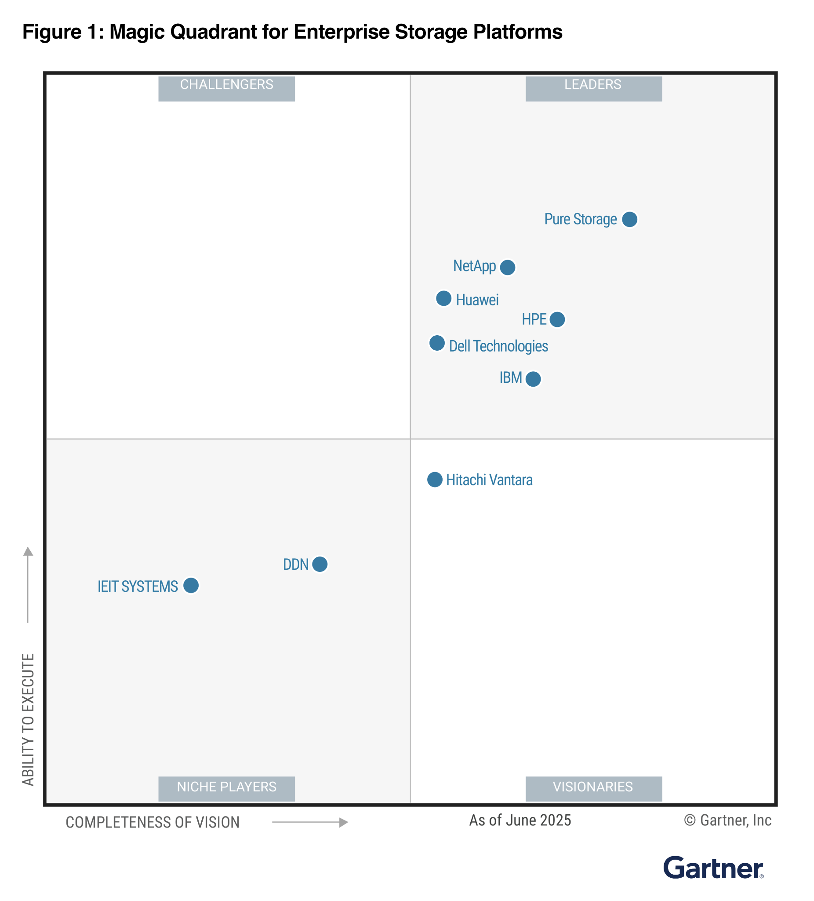

Positioned Highest in Execution, Furthest in Vision
2025 Gartner® Magic Quadrant™ for Enterprise Storage Platforms
Gartner, Inc. and/or its affiliates in the U.S. and internationally, and MAGIC QUADRANT is a registered trademark of Gartner, Inc. and/or its affiliates and are used herein with permission. All rights reserved.
Gartner does not endorse any vendor, product or service depicted in its research publications, and does not advise technology users to select only those vendors with the highest ratings or other designation. Gartner research publications consist of the opinions of Gartner’s research organization and should not be construed as statements of fact. Gartner disclaims all warranties, expressed or implied, with respect to this research, including any warranties of merchantability or fitness for a particular purpose.
This graphic was published by Gartner, Inc. as part of a larger research document and should be evaluated in the context of the entire document. The Gartner document is available upon request from Pure Storage.

Slide 12
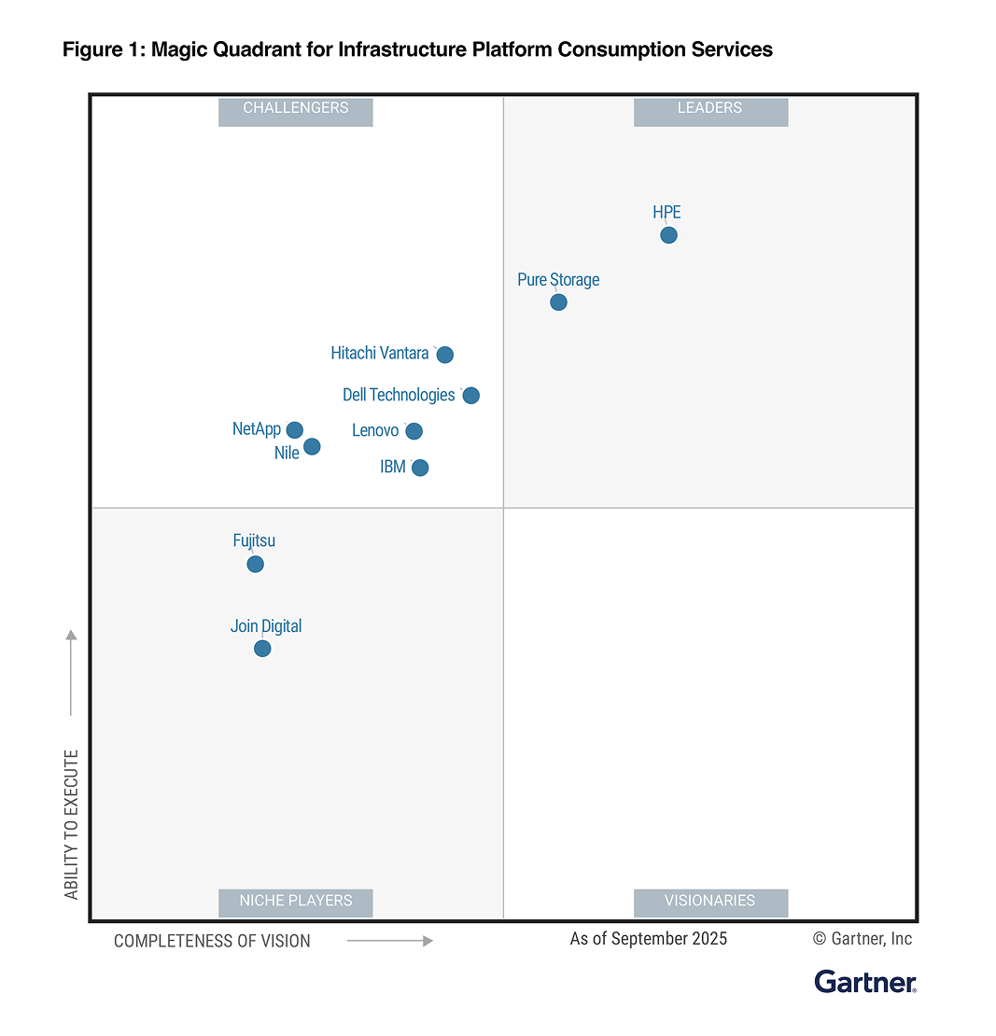
Recognized as a Leader
2025 Gartner® Magic Quadrant™ for Infrastructure Platform Consumption Services

Slide 13
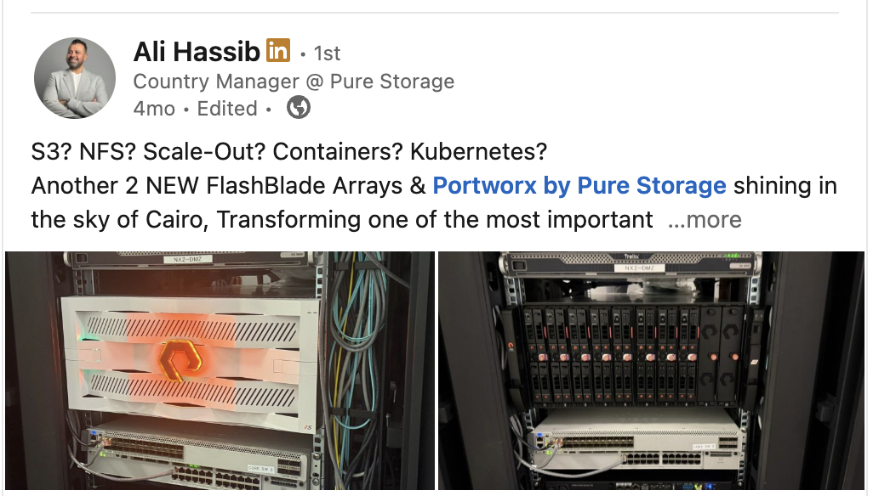
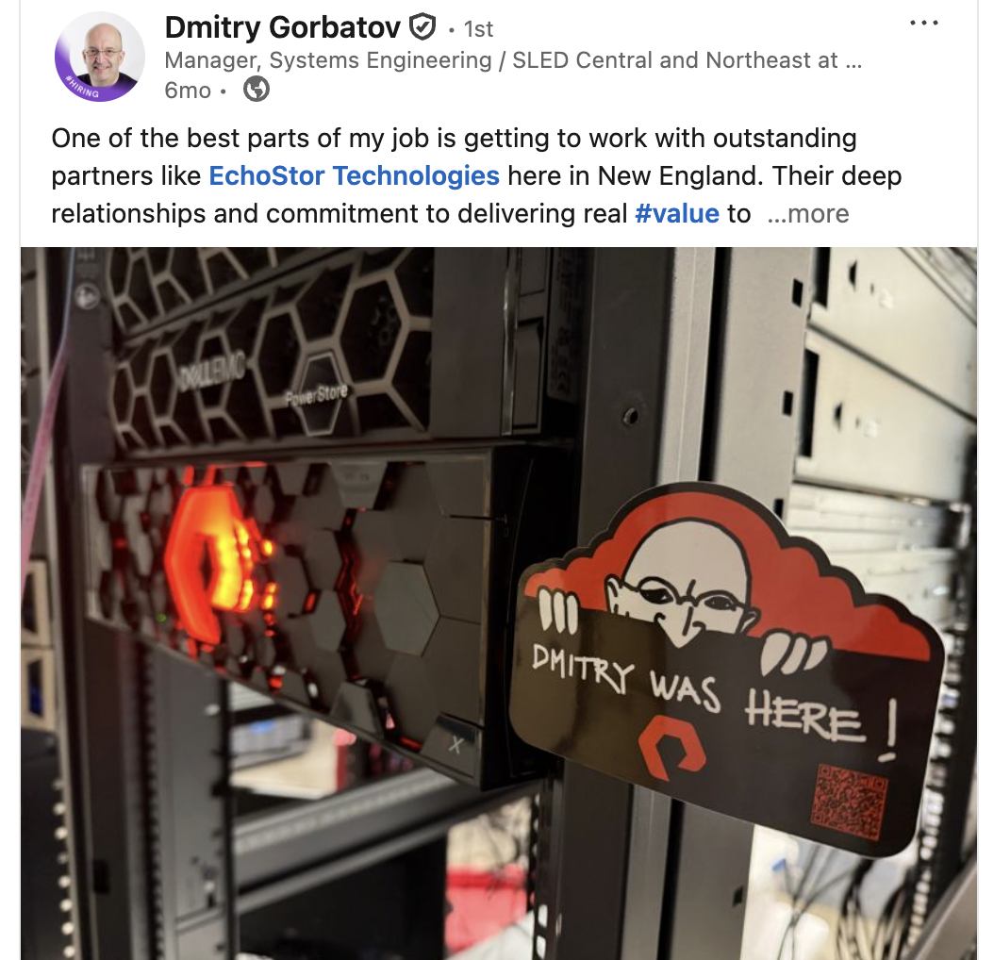
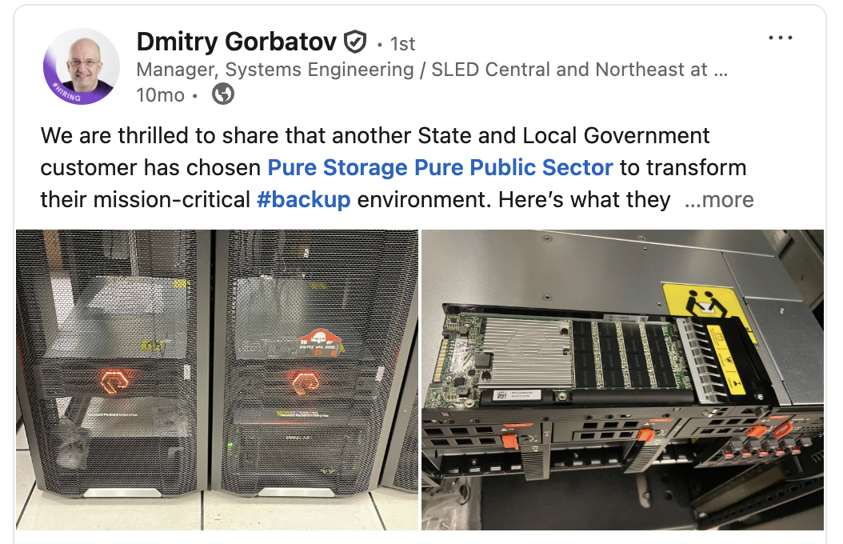
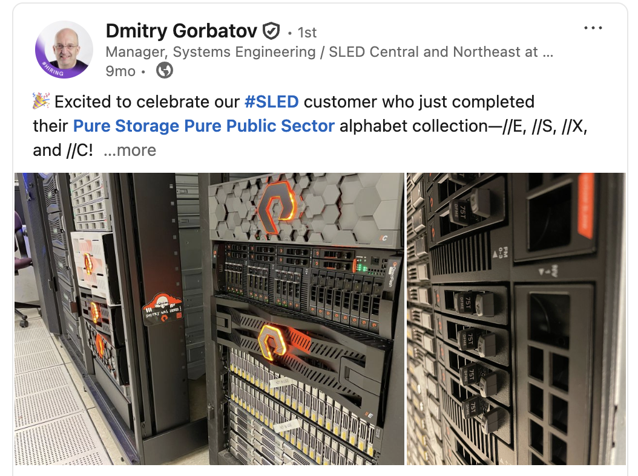
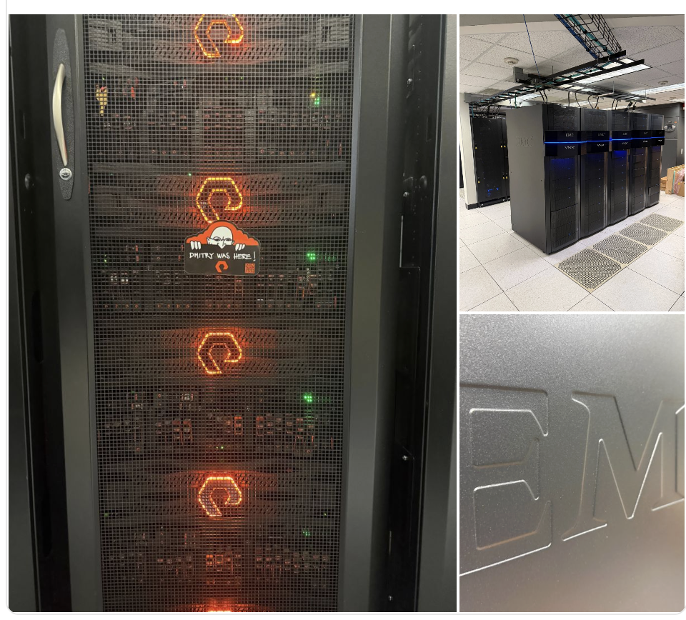
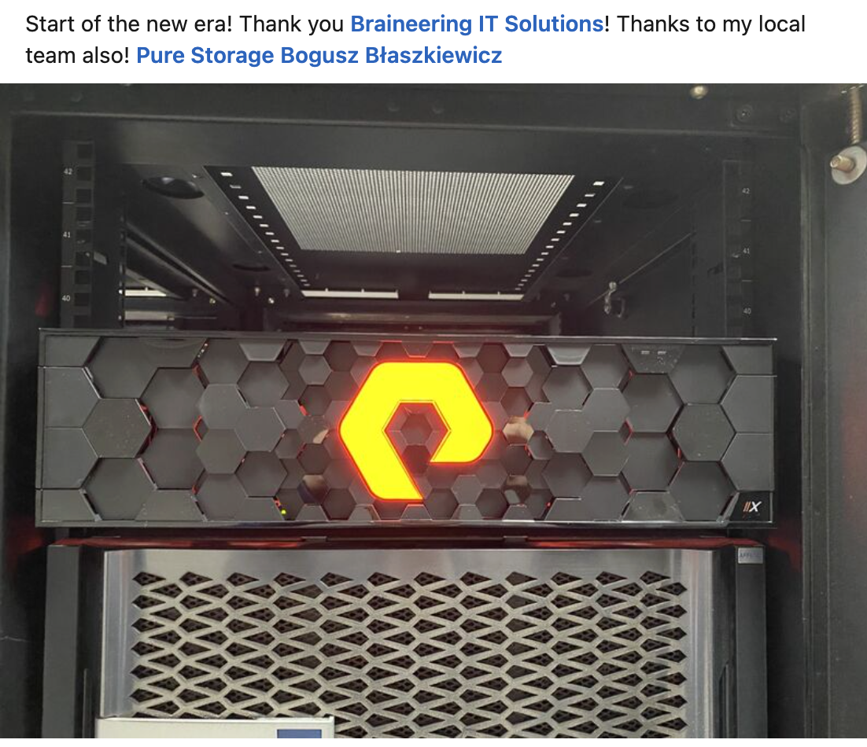
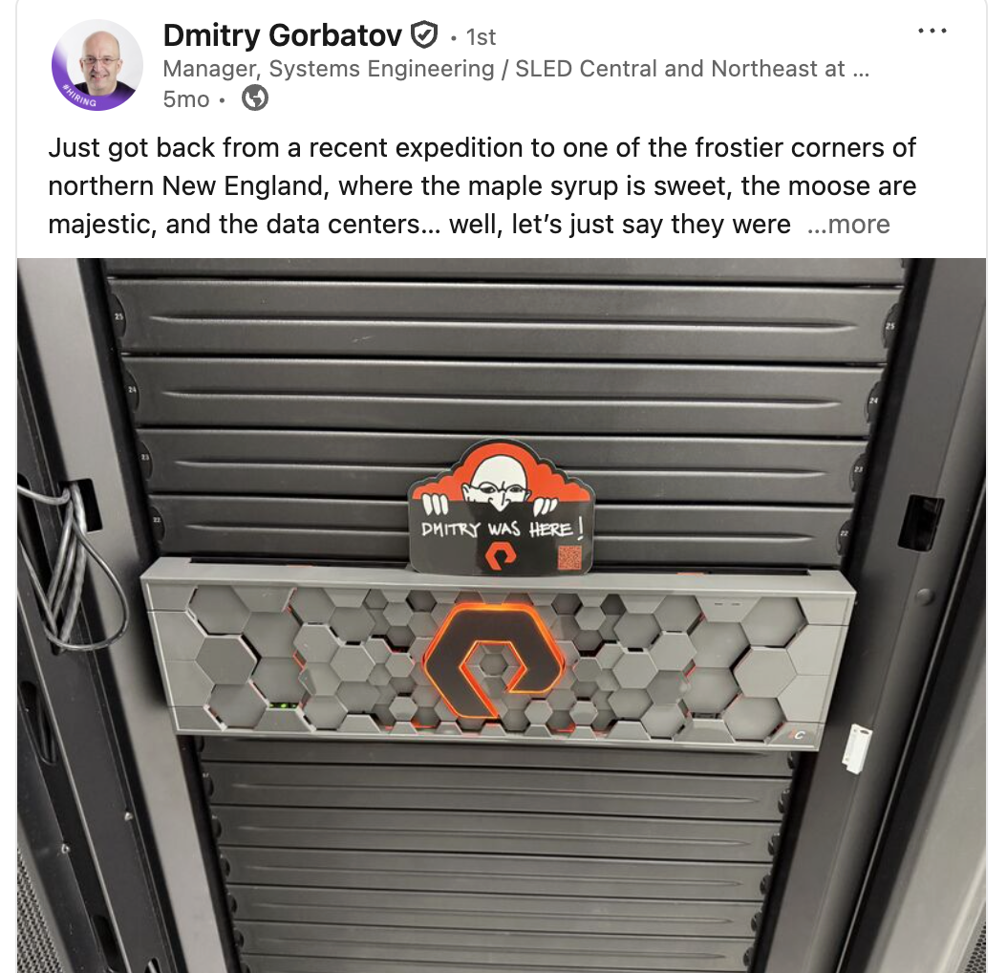
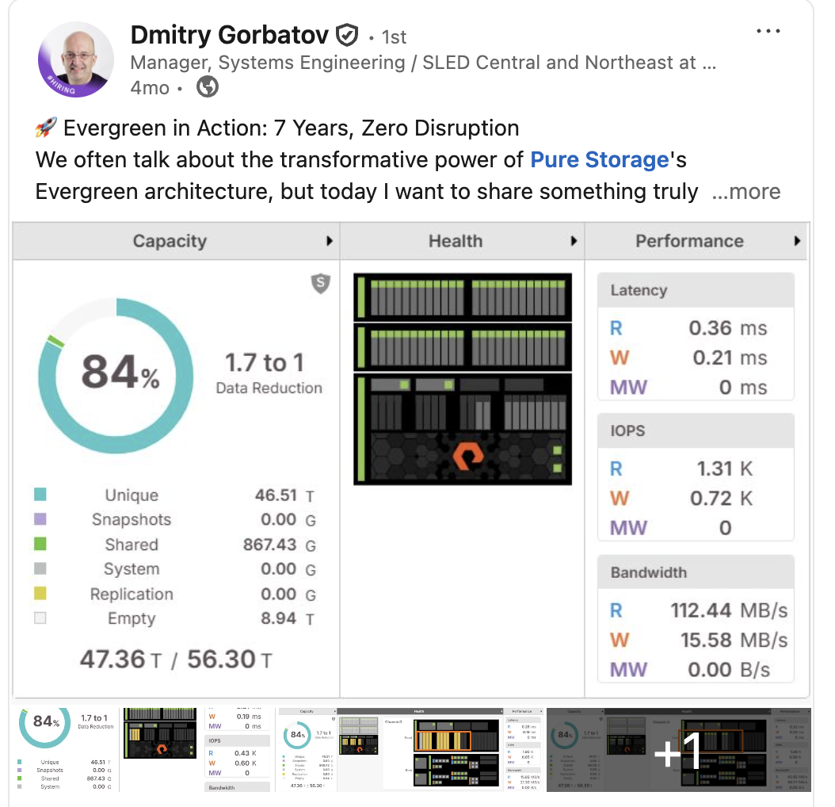
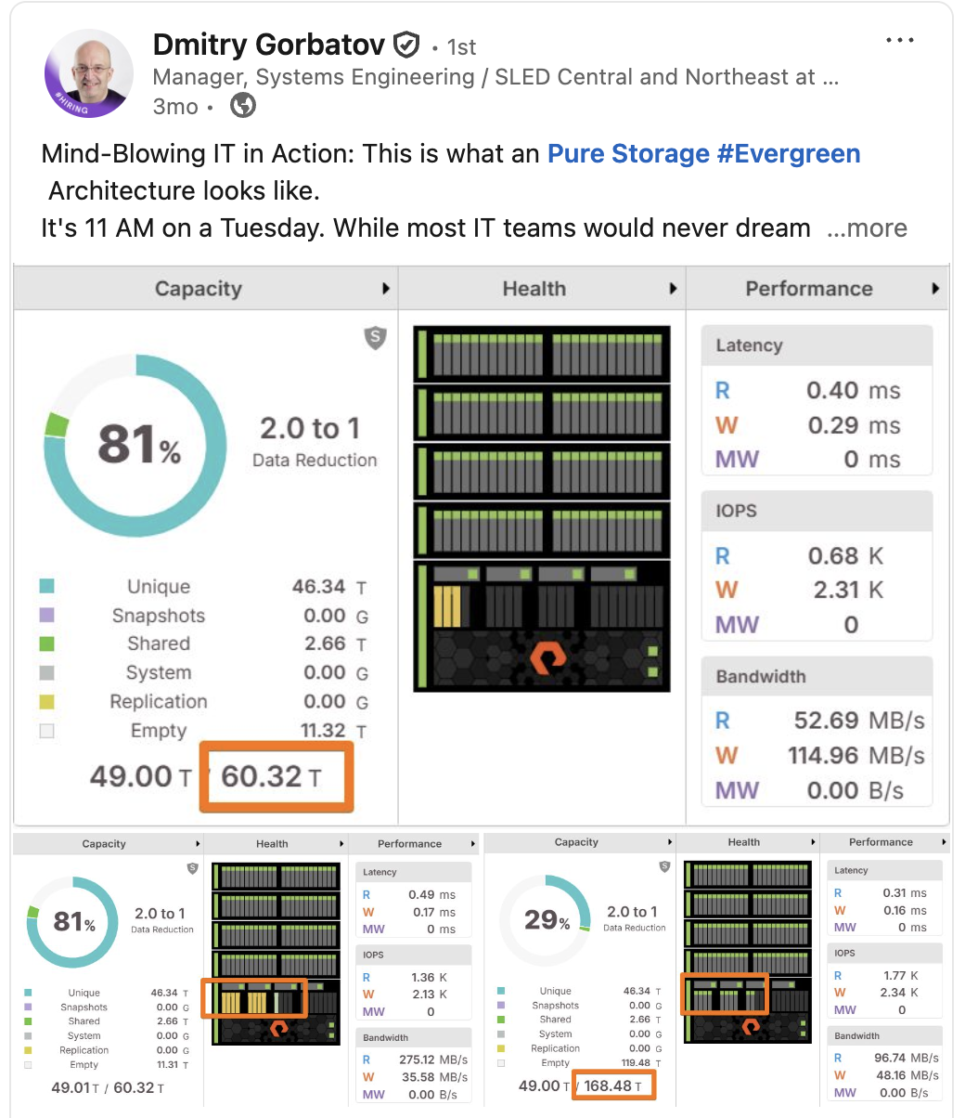
Notes:
Open with the big idea: once you accept that data, not infrastructure, is the foundation, priorities flip.
Call out the baseline: automating storage or tuning infrastructure isn’t the goal — that’s just table stakes.
Use the analogy: infrastructure is the plumbing, but data is what fuels the business and drives the outcome.
In an AI world, managing infrastructure block by block is too slow and too narrow.
The real work is managing data directly — intelligently, automatically, and in real time.
Land the takeaway: this isn’t optimization, it’s survival in a data-led, AI-powered world.

Slide 14
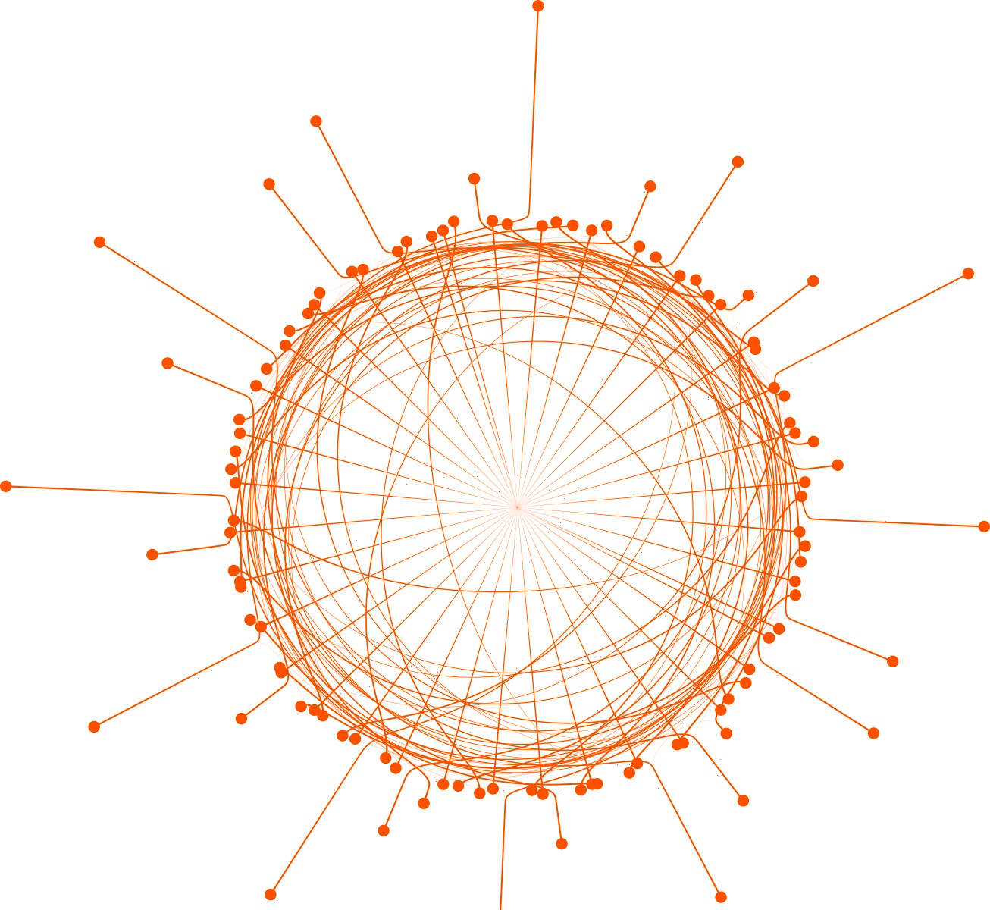
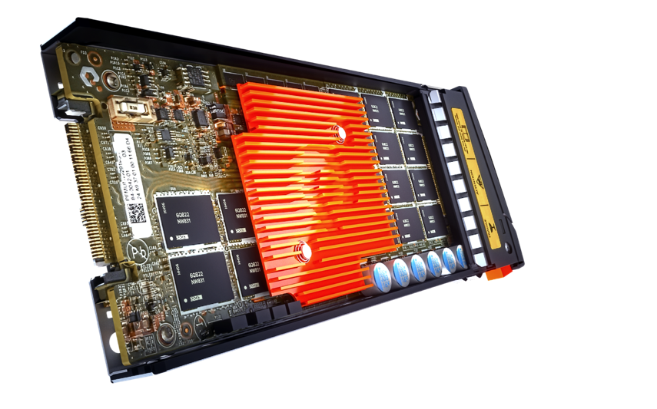
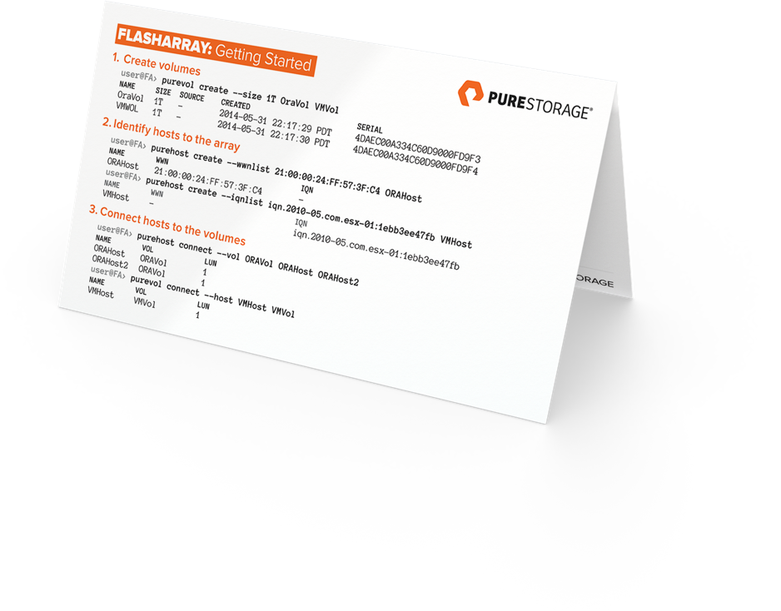
the Grounds of PURE
BUILT FOR NVME Flash
DISRUPTIVELY SIMPLE
EVERGREEN

Slide 15
